Slide 1
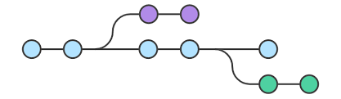
What is branch?
A branch represents an independent line of development... The git branch command lets you create, list, rename, and delete branches. It doesn't let you switch between branches or put a forked history back together again.

Slide 2
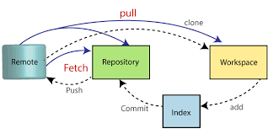
Diff between git pull &git fetch
Git pull: The git pull command is used to fetch and download content from a remote repository and immediately update the local repository to match that content
Git fetch: git fetch can download the code from remote repository to staging area and again merge the code it will goes to the local workspace.

Slide 3
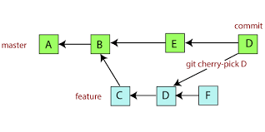
What is cherry pick?
Cherry-picking in Git stands for applying some commit from one branch into another branch. In case you made a mistake and committed a change into the wrong branch, but do not want to merge the whole branch. You can revert the commit and apply it on another branch.
Git cherry-pick <commit id>

Slide 4
How to save uncommitted code in git?
Git stash: The "git stash" command can help you to (temporarily but safely) store your uncommitted local changes - and leave you with a clean working copy.

Slide 5
How to secure git hub?
Never store credentials as code/config in GitHub. ...
Remove Sensitive data in your files and GitHub history. ...
Tightly Control Access. ...
Add a SECURITY.md file. ...
Validate your GitHub Applications Carefully. ...
Add Security Testing to PRs. ...
Use the Right GitHub Offering for your Security Needs. ...
Rotate SSH keys and Personal Access Tokens.

Slide 6
Git branches strategies?
A branching strategy is a convention, or a set of rules, that describes when branches are created, naming guidelines for branches, what use branches should have, and so on

Slide 7
Types of git workflow?
Centralized Workflow.
Feature Branch Workflow.
Gitflow Workflow.
Forking Workflow.

Slide 8
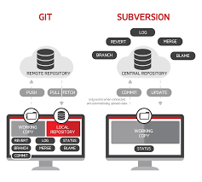
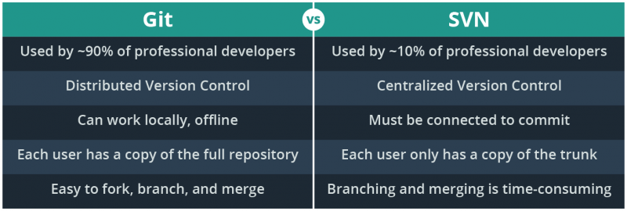
Git vs svn

Slide 9
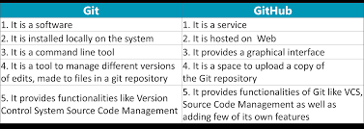
Git vs git hub
Git is a version control system that lets you manage and keep track of your source code history. GitHub is a cloud-based hosting service that lets you manage Git repositories.

Slide 10
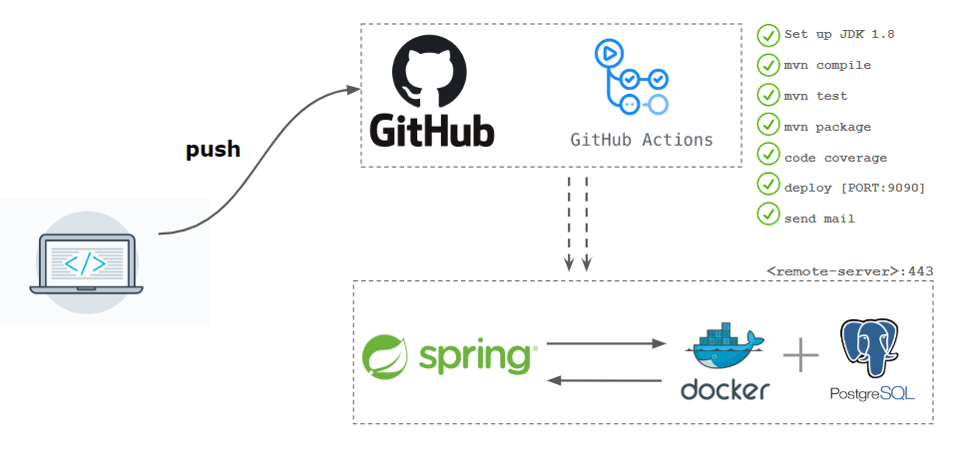
What are the actions in github?
Actions are individual tasks that you can combine to create jobs and customize your workflow.
we can create your own actions, or use and customize actions shared by the GitHub community.

Slide 11
Git fork
Forking in GitHub is a process of creating a copy of a complete repository to the user's GitHub Account from another account
When a user forks a repository, all the files in the repository are automatically copied to the user's account on GitHub and it feels like the user's own repository.

Slide 12
Git merge vs git rebase
git-merge - Join two or more development histories together
SYNTAX:
git merge [-n] [--stat] [--no-commit] [--squash] [--[no-]edit]
[--no-verify] [-s <strategy>] [-X <strategy-option>] [-S[<keyid>]]
[--[no-]allow-unrelated-histories]
[--[no-]rerere-autoupdate] [-m <msg>] [-F <file>] [<commit>…​]
git merge (--continue | --abort | --quit)
Rebase;
In Git, there are two main ways to integrate changes from one branch into another: the merge and the rebase.

Slide 13
How to modified latest commit?
Use git commit --amend to change your latest log message. Use git commit --amend to make modifications to the most recent commit. Use git rebase to combine commits and modify history of a branch.

Slide 14
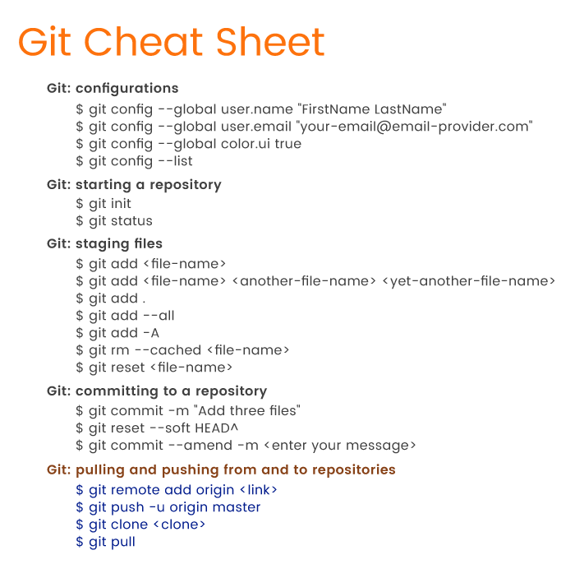
List of git commands?

Slide 15
Types of branches in git?
Master.
Feature branch (aka Topic branch)
Release branch.
Hotfix branch.
Develop branch (aka Integration branch)

Slide 16
Why we need git?
Git is the most commonly used version control system.
Git tracks the changes you make to files, so you have a record of what has been done, and you can revert to specific versions should you ever need to.
Git also makes collaboration easier, allowing changes by multiple people to all be merged into one source.

Slide 17
How to save new file in github?
Step 1: Edit Files in the Working Directory. Edit all the files you have been working on and get them ready to “commit.”
Step 2: Use Git Add Command. When you are satisfied, or ready, to save a copy of the current project as it is, then you stage changes with git add.
Step 3: Commit to Project History.
Step 4:git push origin <branchname>

Slide 18
Git components
The three main components of a Git project: the repository, index, and working tree.
You can think of this as your basic Git workflow: Modify your files in the working tree.

Slide 19
What is repository in git?
A repository contains all of your project's files and each file's revision history.
You can discuss and manage your project's work within the repository.
You can own repositories individually, or you can share ownership of repositories with other people in an organization.

Slide 20
Diff between public repository & private repository
Public Repositories : They're visible to any user on your GitHub Enterprise instance.
Private Repositories : They're only available to the repository owner. You can add collaborators of your choise to share with

